Slide 1
ICON

Slide 2

CONCEPT
Represents the American male, particularly the first icon any of us knows… Dad
Helps men manage every aspect of their busy lives
Entertains
Informs
Guides
Engages
Shows men how to restore their spirit, fuel their body and nourish their mind
Allows men to discover the possibilities regardless of their situation in life
Inspires men to dream big and savor their success

Slide 3
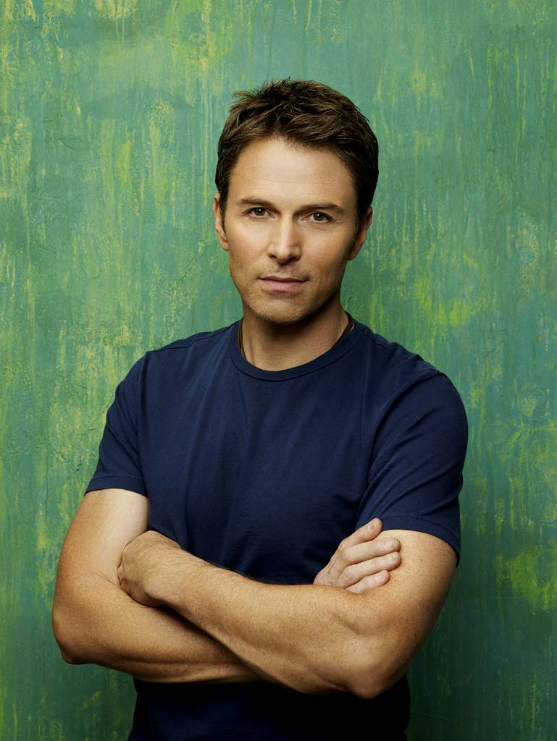
MISSION
ICON symbolizes the American father. It helps him make sense of his chaotic life by providing him the tools he needs to stay in touch with current trends, to find his own sense of style and to create balance between his commitments to family, career and self.
ICON fuels his spirit and nourishes his mind, heightens his awareness to the landscape around him and stimulates his creativity and resourcefulness.
But most of all, ICON empowers and inspires men to discover their passions, follow their dreams and maintain their focus.

Slide 4
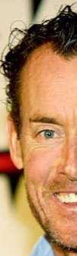
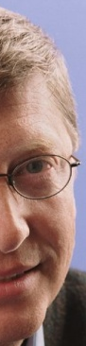
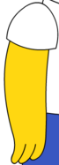
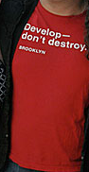
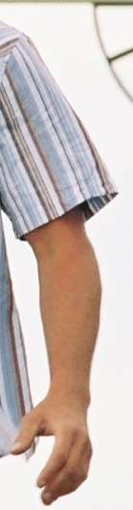
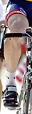
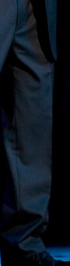
A portrait of the average ICON reader
John C. McGinley
Bill Gates
Adam Richman
Homer Simpson
Ty Pennington
Lance Armstrong
Jay Leno

Slide 5

R&R
Entertainment
Hobbies
Showcase
Sports

Slide 6

PARENTHOOD
THE TO-DO LIST
DR. DAD
SIMPLE THINGS
SINGLE DAD
FAMILY MATTERS

Slide 7

RELATIONSHIPS
CUPID’S TIPS
ROMANCE
SEX!
WHO QUESTIONS SEX?

Slide 8

CAREER
TIME MACHINE
CAREER COACH
ENTREPRENEUR

Slide 9

MONEY
DOLLARS AND SENSE
SAVE IT
FAMILY ICON
RETIREMENT

Slide 10

HEALTH &
WELLNESS
NUTRITION
WORKOUT
IN TRAINING
MEDICAL ADVICE
HOUSE CALLS
STRESS MANAGEMENT

Slide 11

TRAVEL
FAMILY FRIENDLY VACATIONS
ROMANTIC GETAWAYS
ADVENTURE

Slide 12
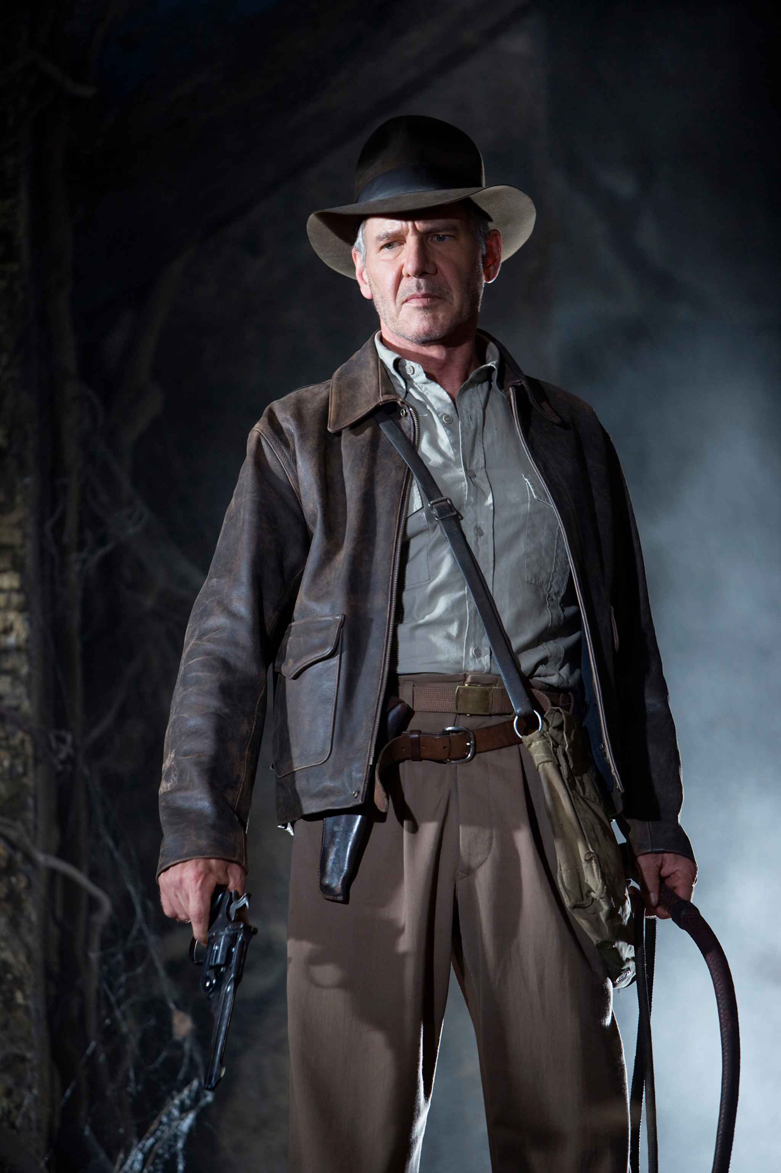
FEATURES
LONGER, IN DEPTH COVERAGE OF CONTENT TOO DETAILED TO PUT IN OUR SECTIONS AND DEPARTMENTS, INCLUDING:
PROFILES
POLITICS
TRAVEL
FOOD
SPORTS
MONEY
ENTERTAINMENT
…AND MORE

Slide 13
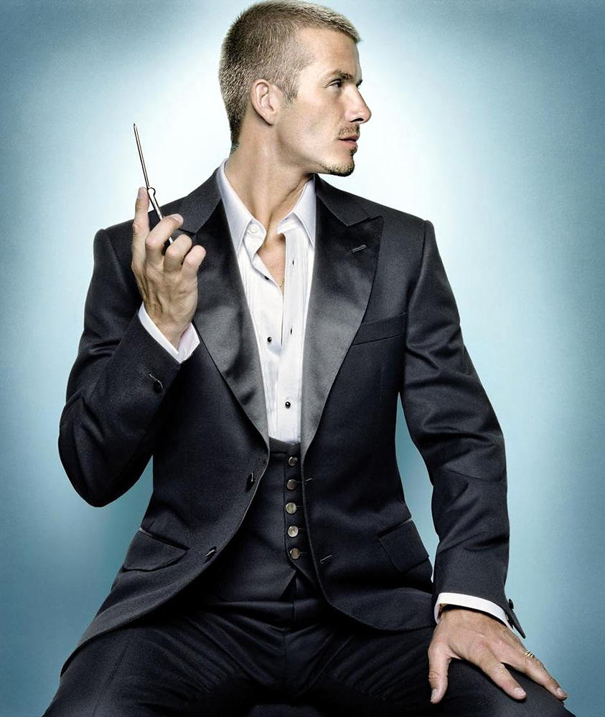
STYLE &
COMFORT
STYLE
COMFORT
STYLE GURU

Slide 14

FOOD
SIMPLE RECIPES
GRILL
FAMILY FARE

Slide 15
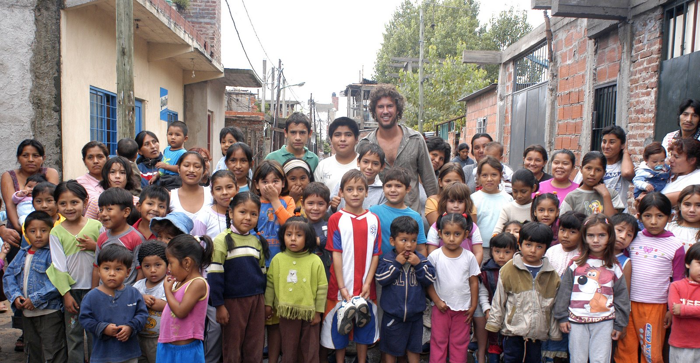
SPIRIT
ME
INSPIRED

Slide 16
ICON

